Slide 1
Demand Predictions with Machine Learning
FMCG – Demand Predictions
26th June 2018
Gaya Premachandra

Slide 2




Problem
Fast Moving Consumer Goods (FMCG)
SKU Level Demand (Sales ) for next 90 days?
Retailer Level Sales for next 90 days?
Notes:
Sku- store keeping unit

Slide 3
Challenges
470 + Stock Keeping Units (SKUs)
3700+ Retailers
Data ?

Slide 4
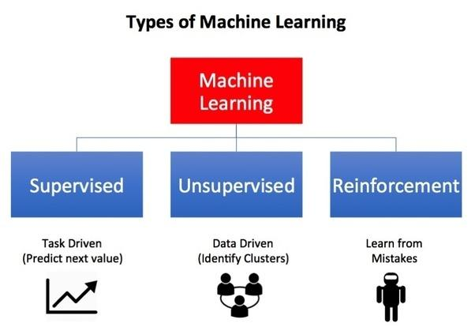
Types Of Machine Learning
Notes:
Supervised – Patten recognizing
Unsupervised – schedule

Slide 5
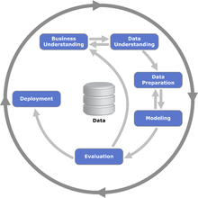
Cross Industry Standard Process
Methodology

Slide 6
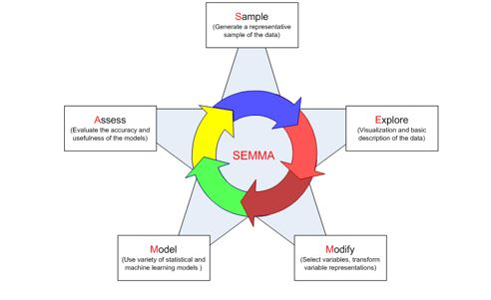
Methodology..

Slide 7
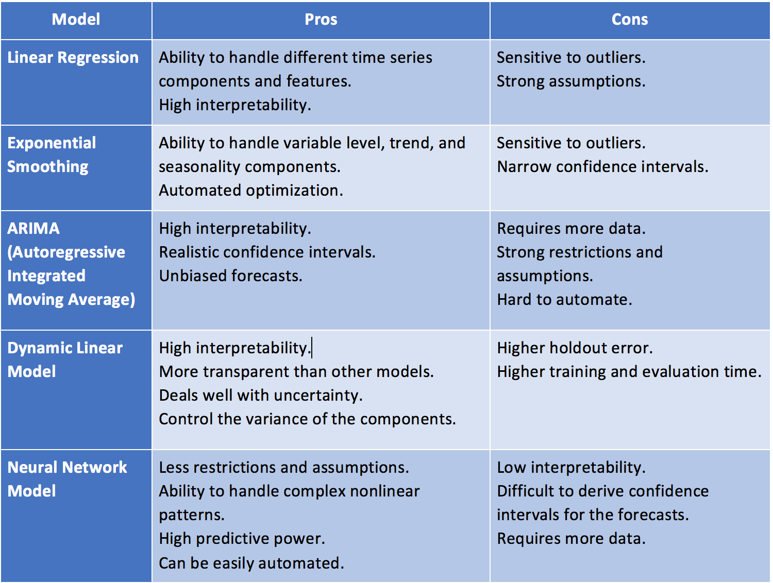
Models

Slide 8
Complex Models
Generalized Autoregressive Conditional Heteroskedasticity (GARCH)
Bayesian-based models
VAR
Neural network models
Neural Networks Autoregression (NNAR)
RNN (Recurrent Neural Network)
LSTM (Long Short-Term Memory)
GRU (Gated Recurrent Unit) networks.

Slide 9
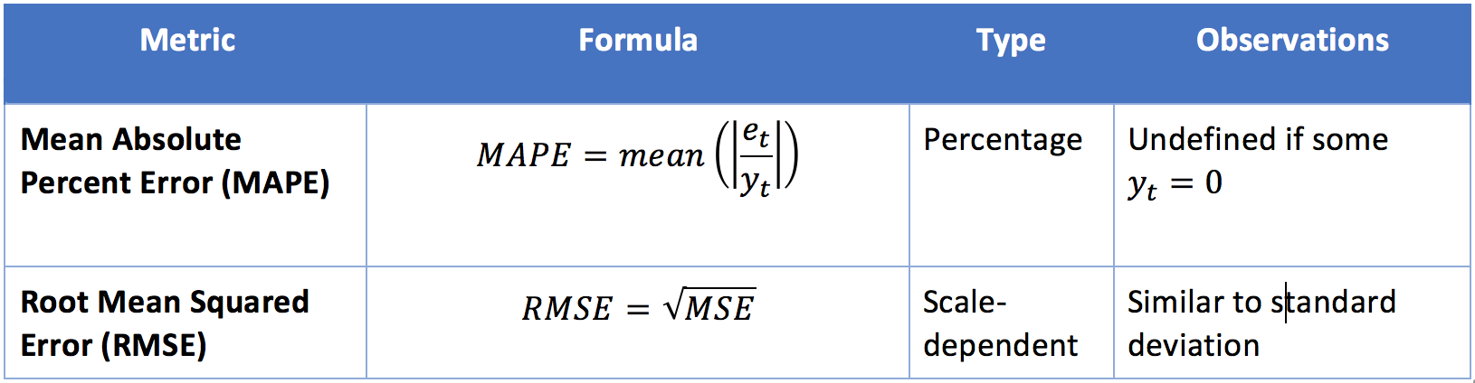
Evaluation Matrix

Slide 10
Thank You!

